Slide 1
TA 3
Pointers, const

Slide 2
Pointers

Slide 3
New & Exciting data type – pointers!
Pointers can be a bit confusing. Don’t panic if you don’t fully understand how to work with them – it will come with practice.
Before we go into pointers, we need to know why we need them.
Consider the following scenario – you want to implement a function to swap between the values of 2 integers. Sounds straight forward, right? Just:
void swap(int a, int b) { int temp = a; a = b; b = temp; }

Slide 4
Pointers – the why
Reminder
void swap(int a, int b) { int temp = a; a = b; b = temp; }
What will be printed from the following program?
int main() { int x = 4; int y = 7; swap(x, y); printf("x = %d, y = %d", x, y); return 0; }
x = 4, y = 7

Slide 5
Pointers – the why
Reminder
void swap(int a, int b) { int temp = a; a = b; b = temp; }
Why didn’t our swap work?
When variables are passed to a function in C/C++, their value is copied to new local variables of the function.
In our example, the local variable “a” was assigned the value 4 and the local variable “b” was assigned the value 7. All the operations in the function were performed on the local variables – not changing anything in the variables of the calling code (“x” and “y”)
So how can we perform swap?
Pointers
x
y
a
b
7
4
7
4 | 7
4
Notes:
The copying of the values – make sure they understand that the pointers also get copied, but that the values still point to the same memory location

Slide 6
What are pointers?
Pointers are data-types!
For every data type – there is a matching pointer
The content of a pointer is a memory address.
We can use pointers to access the memory address they hold – that is why they are called pointers, as they point us to the memory address.
Notes:
Pointers are data types. I cannot stress enough how crucial this is for their understanding.

Slide 7

What are pointers?
You can think of a pointer as a receptionist who knows only the location of the room of a single doctor in the clinic at a given time – the receptionist points you to that doctor’s room.
Important to remember – a pointer is a variable, that means it has a location in the memory and holds a value!
You now have a new mantra – a pointer is a variable!
pointer
Notes:
Pointers are data types. I cannot stress enough how crucial this is for their understanding.

Slide 8
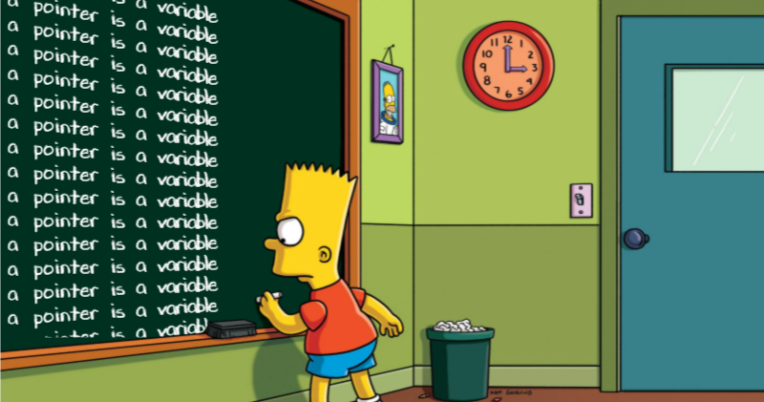
Notes:
Super important – if they remember this, they will have an easier time wrapping their heads on the concept of pointers

Slide 9
Pointers – ‘*’ and ‘&’
There are 2 important operators for pointers – * and &
* is used for 2 purposes:
Declaring a pointer. For example - declaring a pointer called “p” for an int is done in the following way: int *p;
To access the data in the address the pointer contains (go to the doctor the receptionist pointed to). This is called “dereferencing”
& is used to get the address of a variable, for example – if we have an int called “num”, we could get it’s address by calling “&num”
int num = 5; int *p; // declaration - * is used to declare a pointer p = &num; // ampersand - & is used to get the address of num *p = 10; // dereference - * is used to change the value of num

Slide 10
Pointers – simple example
What will be printed from the following code?
10, 10, 10
10, 15, 10
10, 15, 15
10, 10, 15
int num = 10; printf("%d, ", num); int* p = &num; printf("%d, ",*p); *p = 15; printf("%d", num)
Declaring an int variable num, with value 10
Printing “num = 10”
Declaring a pointer to int variable p, with value that is the address of num
Printing “*p = 10”
Changing the value at the memory address p is pointing at to 15
Printing “num = 15”

Slide 11
Pointers – graphical explanation
int num = 10; printf("num = %d", num); int* p = &num; printf("*p = %d",*p); *p = 15; printf("num = %d", num)
Suppose this is our memory:
0 | 1 | 2 | 3 | 4 | 5 | 6 | 7
We now assign “int num = 10”. Let's say “num” is saved in the 7th cell:
 |  |  |  |  |  | 10
0 | 1 | 2 | 3 | 4 | 5 | 6 num | 7
Print the value in the 7th cell
Now we create a pointer “p” for “num” – “int* p = &num”. Let’s say p is saved in the first cell
6 |  |  |  |  |  | 10
0 p | 1 | 2 | 3 | 4 | 5 | 6 num | 7
Now, p “points” to cell 6 (the 7th cell containing the value set for num)
Print the value in the cell p is pointing to - the 7th cell
When we do “*p = 15” we tell the program to go to the address p contains (6 in our example) and change the value written there (which was 10) to 15. Because “num” is just a way to access that location in the memory – num’s value is changed, and when printing it we get the new value
6 |  |  |  |  |  | 15
0 p | 1 | 2 | 3 | 4 | 5 | 6 num | 7

Slide 12
Pointers – back to swap
Now that we know pointers, we can solve our original problem – writing a swap function!
void swap(int *a, int *b) { int temp = *a; *a = *b; *b = temp; }
Notes:
Point out that the pointers are being copied

Slide 13
Pointers – the end
Reminder
void swap(int *a, int *b) { int temp = *a; *a = *b; *b = temp; }
What will be printed from the following program?
int main() { int x = 4; int y = 7; swap(&x, &y); printf("x = %d, y = %d", x, y); return 0; }
x = 7, y = 4

Slide 14
Pointers – the end
Reminder
void swap(int *a, int *b) { int temp = *a; *a = *b; *b = temp; }
What will be printed from the following program?
int main() { int x = 4; int y = 7; swap(&x, &y); printf("x = %d, y = %d", x, y); return 0; }
x
y
a
b
0x00
0x01
4 | 7
0x00 | 0x01

Slide 15
Pointers – the end
Reminder
void swap(int *a, int *b) { int temp = *a; *a = *b; *b = temp; }
What will be printed from the following program?
int main() { int x = 4; int y = 7; swap(&x, &y); printf("x = %d, y = %d", x, y); return 0; }
x
y
a
b
0x00
0x01
4 | 7
0x00 | 0x01

Slide 16
Pointers – the end
Reminder
void swap(int *a, int *b) { int temp = *a; *a = *b; *b = temp; }
What will be printed from the following program?
int main() { int x = 4; int y = 7; swap(&x, &y); printf("x = %d, y = %d", x, y); return 0; }
x
y
temp
a
b
0x00
0x01
4 | 7 | 4
0x00 | 0x01

Slide 17
Pointers – the end
Reminder
void swap(int *a, int *b) { int temp = *a; *a = *b; *b = temp; }
What will be printed from the following program?
int main() { int x = 4; int y = 7; swap(&x, &y); printf("x = %d, y = %d", x, y); return 0; }
x
y
temp
a
b
0x00
0x01
4 | 7 | 4
0x00 | 0x01

Slide 18
Pointers – the end
Reminder
void swap(int *a, int *b) { int temp = *a; *a = *b; *b = temp; }
What will be printed from the following program?
int main() { int x = 4; int y = 7; swap(&x, &y); printf("x = %d, y = %d", x, y); return 0; }
x
y
temp
a
b
0x00
0x01
7 | 7 | 4
0x00 | 0x01

Slide 19
Pointers – the end
Reminder
void swap(int *a, int *b) { int temp = *a; *a = *b; *b = temp; }
What will be printed from the following program?
int main() { int x = 4; int y = 7; swap(&x, &y); printf("x = %d, y = %d", x, y); return 0; }
x
y
temp
a
b
0x00
0x01
7 | 4 | 4
0x00 | 0x01

Slide 20
Pointers – the end
Reminder
void swap(int *a, int *b) { int temp = *a; *a = *b; *b = temp; }
What will be printed from the following program?
int main() { int x = 4; int y = 7; swap(&x, &y); printf("x = %d, y = %d", x, y); return 0; }
x = 7, y = 4
x
y
7 | 4
0x00 | 0x01

Slide 21
Const

Slide 22
C’s const qualifier
First, we need to understand the difference between compilation time and runtime
Compilation time – when the code is being translated to machine code
Runtime – when the computer executes the compiled code.
We prefer compilation errors over runtime errors!
We can apply the “const” qualifier to any variable declaration to state that the value of the variable won’t be changed.
const double E = 2.71828; E = 10.5; //Compilation error!

Slide 23
C’s const qualifier
The value of a const variable can only be set in the declaration line
The value doesn’t have to be known in compile time
const double E; E = 10.5; //Compilation error!
const char c = getchar(); //OK

Slide 24
C’s const qualifier - structs
All members of a const struct are const!
typedef struct Complex { int _img; int _real; } Complex ; int main() { Complex const COMPLEX1 = {1,2}; //OK, copying values Complex COMPLEX2 = COMPLEX1; //OK, copying values COMPLEX1 = COMPLEX2; //Compilation error COMPLEX1._img = 3; //Compilation error return 0; }

Slide 25
C’s const qualifier – who does it protect?
Const always applies to the left, only if there is nothing on the left it applies to the right.
This means the following are equivalent
const int arr[5] = {1, 2, 3, 4, 5}; arr[1] = 10; //Compilation error
int const arr[5] = {1, 2, 3, 4, 5}; arr[1] = 10; //Compilation error

Slide 26

C’s const qualifier – who does it protect?
We must be careful and understand what the const protects
int a = 1; int const *p = &a; //const protects to the left // pointer to a const variable *p = 2; //Compilation error - value is const! p = NULL; // legal. The data in the pointer can change.
ptr
value
int a = 1; const int* p = &a; //const protects to the right // pointer to a const variable *p = 2; //Compilation error - value is const! p = NULL; // legal. The data in the pointer can change.
ptr
value
int a = 1; int *const p = &a; //const protects to the left // const pointer to a variable *p = 2; //OK p = NULL; //Compilation error - the value of the //pointer is const!
ptr
value

Slide 27
C’s const qualifier – who does it protect?
So if we want both…
int a = 1; const int *const p = &a; //const protects to the left, if no
// left to right const pointer to a const variable *p = 2; // Compilation error p = NULL; //Compilation error - the value of the pointer is const!
ptr
value

Slide 28
C’s const qualifier – arrays
Arrays are const (implicitly)
This does not mean the values in the array are const, but that we cannot assign a new value to the array after initialization
int arr1[5] = {1, 2, 3, 4, 5}; int arr2[5]; arr2 = arr1; // Compilation error

Slide 29
C’s const qualifier – in functions
The const qualifier can (and should!) be applied in the definition of the program arguments, if that argument’s value will not change in the function
This is not a recommendation, but a must:
Clearer code
Avoids errors
Part of the interface you define!
void func(const int a, const double b)
{ //... }
Notes:
Part of the interface – it tells you whether a function alters the given argument or not (strlen, strcmp for example…)
Points will be deduced in the following exercises for not using const!

Slide 30
C’s const qualifier
What will the code print?
p is 10!
Nothing, compilation error
Nothing, runtime error
p is not 10!
void foo(const int *p) { if (*p = 10) { printf("p is 10!"); } else { printf("p is not 10!"); } }
int main() { int a = 5; foo(&a); return 0; }
Notes:
The point here is that we missed a = in the if, since the argument is const – it won’t compile!

Slide 31
C’s const qualifier – casting
The const qualifier does protect from “evil changes” – we can get around it by “casting it away”
const int a = 5; a = 10; // Compilation error int* c = &a; *c = 10; // compiles, but undefined behavior
Notes:
Part of the interface – it tells you whether a function alters the given argument or not (strlen, strcmp for example…)
Points will be deduced in the following exercises for not using const!

Slide 32
Pointers Arithmetic

Slide 33
Pointer arithmetic
Pointers are variables and contain values.
These values can be manipulated – increased, decreased, compared etc.
When we change the value of a pointer, we change the address it points to.
Note – *(ptr+1) and ptr[1] are equivalent.

Slide 34
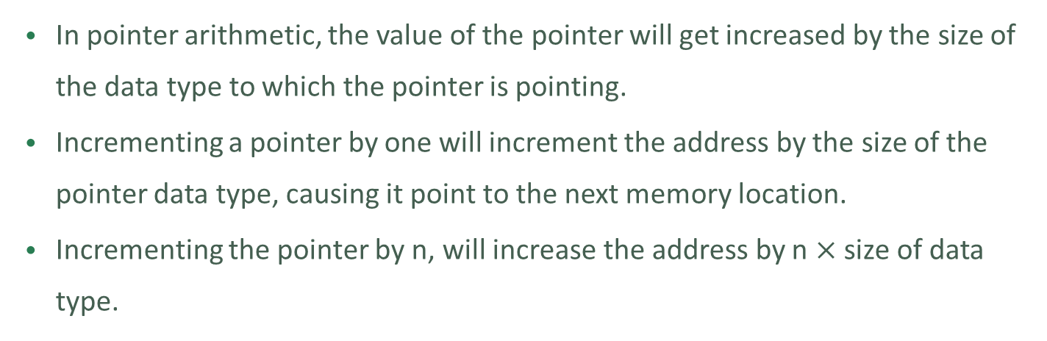
Pointer arithmetic
In pointer arithmetic, the value of the pointer will get increased by the size of the data type to which the pointer is pointing.
Incrementing a pointer by one will increment the address by the size of the pointer data type, causing it point to the next memory location.
Incrementing the pointer by n, will increase the address by n $×$ size of data type.
char_ptr
char_ptr
char_ptr
char c; char* char_ptr = &c;
char_ptr++;
char_ptr = char_ptr + 3;

Slide 35
Pointer arithmetic
In pointer arithmetic, the value of the pointer will get increased by the size of the data type to which the pointer is pointing.
Incrementing a pointer by one will increment the address by the size of the pointer data type, causing it point to the next memory location.
Incrementing the pointer by n, will increase the address by n $×$ size of data type.
int_ptr
int_ptr
int c = 2; int* int_ptr = &c;
int_ptr++;

Slide 36
Arrays vs. Pointers

Slide 37
Array as Pointer
An array is a block of sequential data. In most contexts, array names are converted to pointers. That’s mean you can use pointers to access elements of arrays.
However, you should remember that pointers and arrays are not the same.
int arr[2] = {1, 2}; int* p = arr; // p points to the first location of the array printf("%d %d", *p, *(p + 1)); // prints 1 2

Slide 38
Array as Pointer
char str[] = "SomeText"; int *intPointer = (int *) str; char *charPointer = str; printf("%c %c\n", *intPointer, *charPointer); printf("%c %c", *(++intPointer), *(++charPointer));
The code prints “S S
T o”
Pointers are incremented and decremented according to their type!
str
intPointer
S | o | m | e | T | e | x | t | \0
charPointer
++charPointer
++intPointer

Slide 39
Array as Argument
When we pass array to a function, the function gets it as a pointer to the first element in the array.
0x00
0x04
0x08
0x012
0x16
0x20
0x24
0x28
1
2
3
0x00
1
2
3
void fun(int arr_arg[]) { printf("%p %d", arr_arg, *arr_arg); } int main () { int arr[3] = {1, 2, 3}; fun(arr); return 0; }
0x00 1
arr_arg

Slide 40
Array as Argument
void fun(int arr_arg[]) { printf("%lu\n", sizeof(arr_arg)); int n = sizeof(arr_arg) / sizeof(int); for (int i = 0; i < n; i++) { printf("%d\n", arr_arg[i]); } } int main () { int arr[3] = {1, 2, 3}; printf("%lu\n", sizeof(arr)); fun(arr); int n = sizeof(arr) / sizeof(int); for (int i = 0; i < n; i++) { printf("%d\n", arr[i]); } return 0; }
8
0x00
0x04
0x08
0x012
0x16
0x20
0x24
0x28
1
2
3
0x00
n = 8 / 4
12
n = 12 / 4
arr_arg

Slide 41
Array as Argument
What is the problem in the next code?
void fun(int arr_arg[]) { arr_arg++; // ok, pointers arithmetic } int main () { int arr[3] = {1, 2, 3}; fun(arr); arr++; // no such operator for array! return 0; }

